Slide 1

Navigation and Route
Emerging Technology : Flutter
Week 2
Program Studi Teknik Informatika
Fakultas Teknik – Universitas Surabaya

Slide 2

STATELESS VS STATEFUL
01

Slide 3
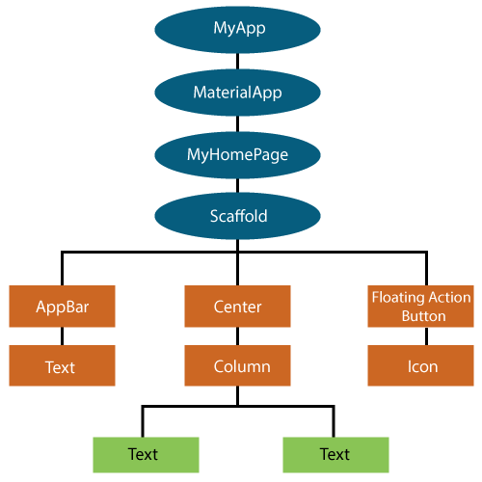
Flutter Widget
A widget is the basic building block of the Flutter framework
Everything you see on the screen in a Flutter app i.e: text, buttons, images, layouts, is a widget
Flutter uses a widget tree structure: widgets are nested inside each other to build the entire UI
Think of a widget as both a visual element (like a button or text) and a structural element (like padding or row/column layout).

Slide 4
Stateless vs Stateful
Widgets in Flutter are divided into two main types:
Stateless widgets cannot change their state during the runtime of the app, which means the widgets cannot be redrawn while the app is in action.
Example: A static text label
Stateful widgets have a mutable state, i.e., they are mutable and can be drawn multiple times within its lifetime. They are the widgets which can change their state multiple times and can be redrawn on to the screen any number of times while the app is in action.
Example: A counter that increases when a button is pressed
Notes: Stateful widget can use setState() method

Slide 5
Skeleton
Stateless Statefull
class AboutScreen extends StatelessWidget {
@override
Widget build(BuildContext context) {
return Scaffold(
appBar: AppBar(
title: Text('About'),
),
body: Center(
child: Text("Example Text"),
),
);
}
}
class MyApp extends StatefulWidget {
@override
State<StatefulWidget> createState() {
return _MyAppState();
}
}
class _MyAppState extends State<MyApp> {
@override
Widget build(BuildContext context) {
return Scaffold(
appBar: AppBar(
title: Text('ExampleApp'),
),
body: Center(
child: Text("Example Text"),
),
);
}
}
Every widget has a build() method that returns the widget tree for what should be displayed

Slide 6
Skeleton
Stateless Statefull
class AboutScreen extends StatelessWidget {
@override
Widget build(BuildContext context) {
return Scaffold(
appBar: AppBar(
title: Text('About'),
),
body: Center(
child: Text("Example Text"),
),
);
}
}
class MyApp extends StatefulWidget {
@override
State<StatefulWidget> createState() {
return _MyAppState();
}
}
class _MyAppState extends State<MyApp> {
@override
Widget build(BuildContext context) {
return Scaffold(
appBar: AppBar(
title: Text('ExampleApp'),
),
body: Center(
child: Text("Example Text"),
),
);
}
}
Unlike a StatelessWidget, a StatefulWidget has a State object that manages changes
This is the state class for MyApp. All the mutable state (like variables that change) would live here. When state changes, calling setState() will rebuild the UI

Slide 7
THE SCAFFOLD
02

Slide 8
What is Scaffold
A Scaffold Widget provides a framework which implements the basic material design visual layout structure of the flutter app. It provides APIs for showing drawers, snack bars and bottom sheets. Have a look at its constructor and the properties it has.
Think of it like an empty page template that already has slots for common UI elements (app bar, body, drawer, floating action button, etc.).
appBar , body, and FAB is already shown in the default project
const Scaffold({
Key key,
this.appBar,
this.body,
this.floatingActionButton,
this.floatingActionButtonLocation,
this.floatingActionButtonAnimator,
this.persistentFooterButtons,
this.drawer,
this.endDrawer,
this.bottomNavigationBar,
this.bottomSheet,
this.backgroundColor,
this.resizeToAvoidBottomPadding = true,
this.primary = true,
})

Slide 9
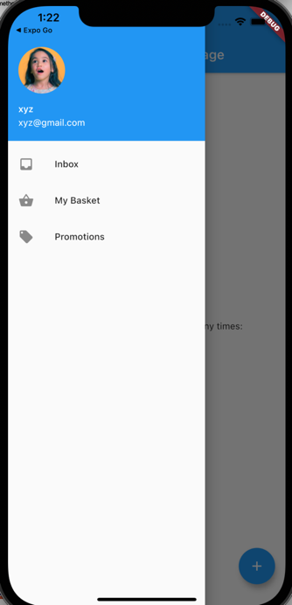
Drawer
Add this drawer object in your scaffold
drawer: Drawer(
elevation: 16.0,
child: Column(
children: <Widget>[
const UserAccountsDrawerHeader(
accountName: Text("xyz"),
accountEmail: Text("xyz@gmail.com"),
currentAccountPicture: CircleAvatar(
backgroundImage: NetworkImage("https://i.pravatar.cc/150"),
),
),
ListTile(
title: const Text("Inbox"),
leading: const Icon(Icons.inbox),
onTap: () {},
),
ListTile(
title: const Text("My Basket"),
leading: const Icon(Icons.shopping_basket),
onTap: () {},
),
],
),
),
Flutter Drawer
https://youtu.be/WRj86iHihgY?si=6f-iyJom0PvNQ6N7
Flutter ListTile
https://youtu.be/l8dj0yPBvgQ?si=8occoT4OVrbtKDRm
Flutter Column
https://api.flutter.dev/flutter/widgets/Column-class.html

Slide 10
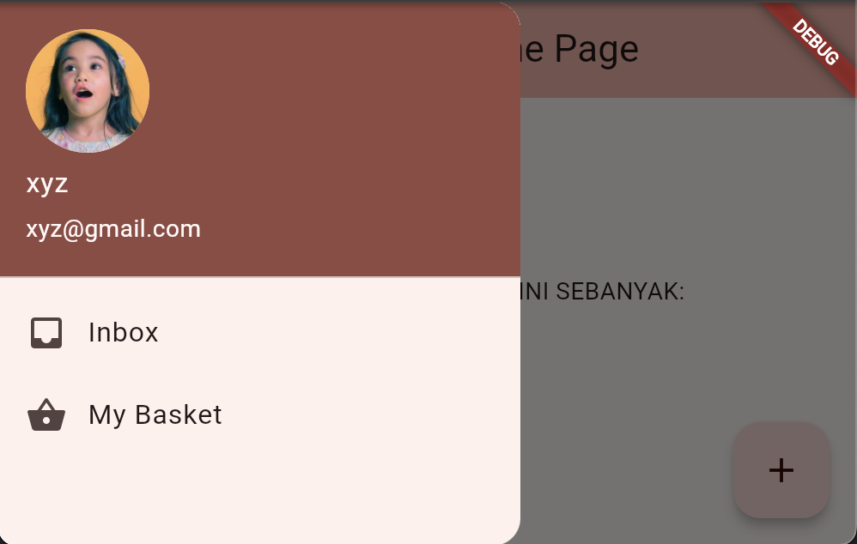
Image not showing in browser ?
That's normal, and this is due to a browser security feature known as Cross-Origin Resource Sharing (CORS).
Quick workaround -> use following command when running flutter project
flutter run -d chrome --web-browser-flag "--disable-web-security"

Slide 11
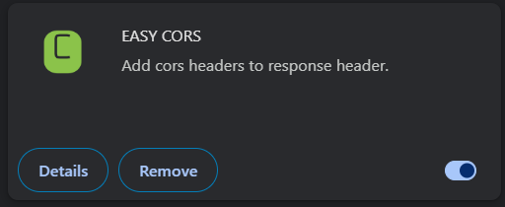
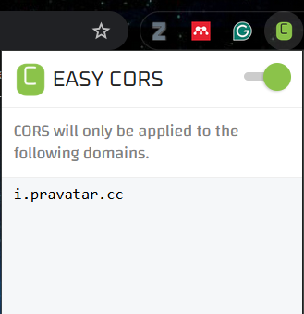
Alternatively
To solve this, we can add a CORS Blocker extension to the browser.
It is recommended to use the Google Chrome browser. In the extensions section, please install the EASY CORS Blocker extension.
Add the link you want to block CORS.
This problem will not arise if you test using an emulator or smartphone.

Slide 12
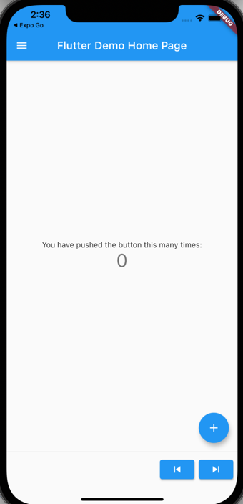
persistentFooterButton
persistentFooterButtons is a list of buttons that are displayed at the bottom of the scaffold. These buttons are persistently visible, even if the body of the scaffold scrolls. They will be wrapped in a ButtonBar and are rendered above the bottomNavigationBar but below the body
persistentFooterButtons: <Widget>[
ElevatedButton(
onPressed: () {},
child: const Icon(Icons.skip_previous),
),
ElevatedButton(
onPressed: () {},
child: const Icon(Icons.skip_next),
),
],

Slide 13
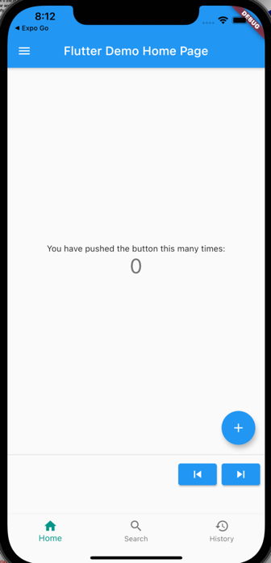
BottomNavigationBar
Is used to display a navigation bar at the bottom of the scaffold. It is rendered below the persistentFooterButtons and the body.
bottomNavigationBar: BottomNavigationBar(
currentIndex: 0,
fixedColor: Colors.teal,
items: const [
BottomNavigationBarItem(
label: "Home",
icon: Icon(Icons.home),
),
BottomNavigationBarItem(
label: "Search",
icon: Icon(Icons.search),
),
BottomNavigationBarItem(
label: "History",
icon: Icon(Icons.history),
),
],
onTap: (int index) {
setState(() {});
},
),
BottomNavigationBar
https://www.youtube.com/watch?v=VfUUOI6BUtE

Slide 14
Tidy up
it is common to make the main structure is not full of code.
Programmer often put body, drawer, bottomnavigationbar widget in a separate function.
We will put the drawer in a function. Create this function within _MyHomePageState class
Widget myDrawer(){
return
....
;
}
Put Drawer(…)
from scaffold drawer here.
Then change the scaffold drawer with this:
drawer: myDrawer(),

Slide 15
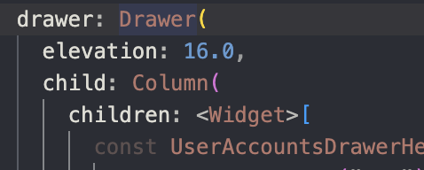
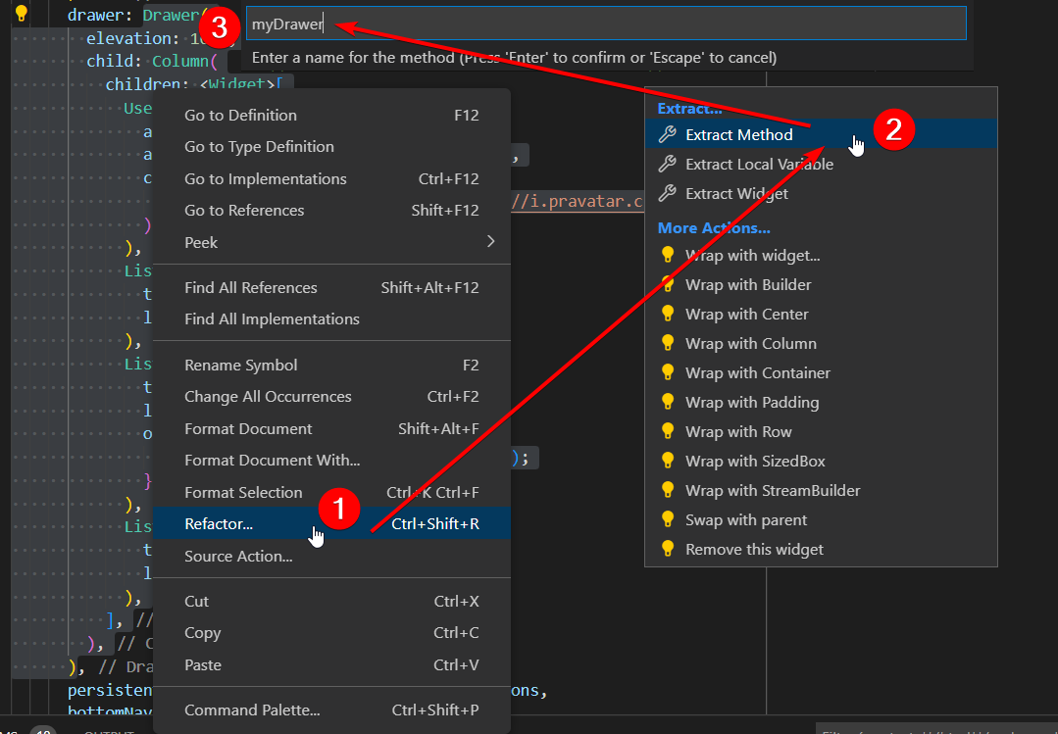
Refactor is your friend!
right click here
Instead of creating the method manually (cutting the whole Drawer() code, creating a new method, and pasting your code inside the new method), use the Refactor feature of your IDE.
Usually: Right click on the widget name Drawer select Refactor and select Extract Method.
Give your method a name, then you’re done.

Slide 16
OPEN NEW SCREEN
03

Slide 17
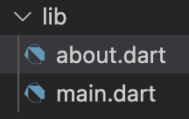
Make a new screen
You can put a new screen file inside lib folder or put in a specific folder inside lib folder for structure neatness.
We will create an about screen and save in lib\screen\about.dart using stateless skeleton.
Right click on lib folder and choose “new file”. And then type “about.dart”, press enter.
Tips: you can use flutter snippet stless or stful in the about.dart to start generate boilerplate template class
import 'package:flutter/material.dart';
class About extends StatelessWidget {
const About({super.key});
@override
Widget build(BuildContext context) {
return Scaffold(
appBar: AppBar(title: const Text('About')),
body: const Center(child: Text("This is About ")),
);
}
}
super.key → passes a unique Key to the parent class (StatelessWidget / StatefulWidget). Helps Flutter differentiate widgets in the tree. It prevents unnecessary rebuilds and ensures state consistency.

Slide 18
Navigator Push
The push() method adds a Route to the stack of routes managed by the Navigator. Where does the Route come from? You can create your own, or use a MaterialPageRoute, which is useful because it transitions to the new route using a platform-specific animation.
Add new ListTile in drawer that push the about screen
Go back to main.dart, add following code inside drawer (below ListTile MyBasket
ListTile(
title: const Text("About"),
leading: const Icon(Icons.help),
onTap: () {
Navigator.push(
context,
MaterialPageRoute(builder: (context) => const About()),
);
},
)

Slide 19
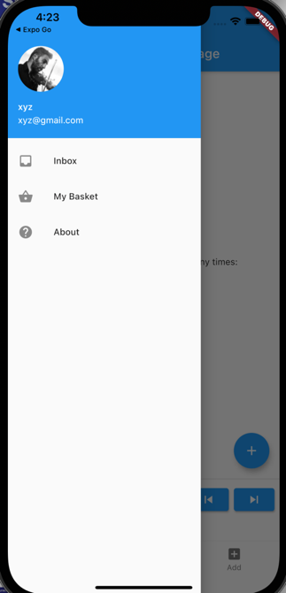
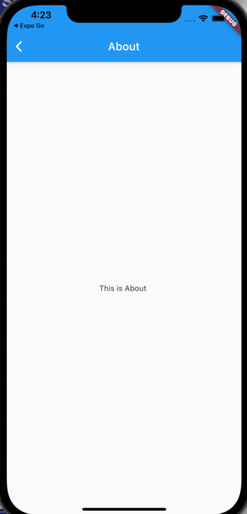
Result

Slide 20
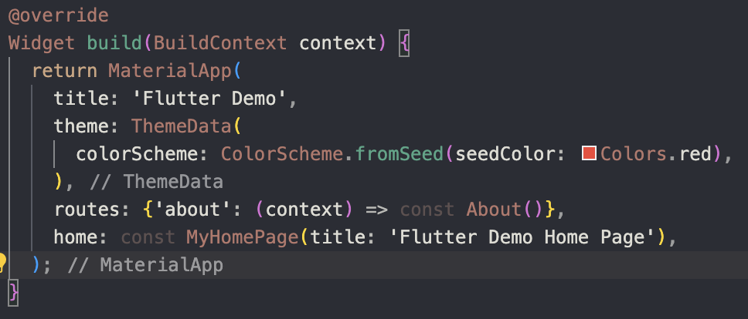
Named Route
The route can be named in order to shorten the route calling.
Still in main.dart, add following import:
import 'about.dart';
And then add this code in MaterialApp(..
routes: {
'about': (context) =>const About(),
},
You can add another route here
And modify the route calling
Drawer often use
popAndPushNamed
Navigator.pushNamed(context, "about");

Slide 21
ROUTING WITH PARAMETER
04

Slide 22
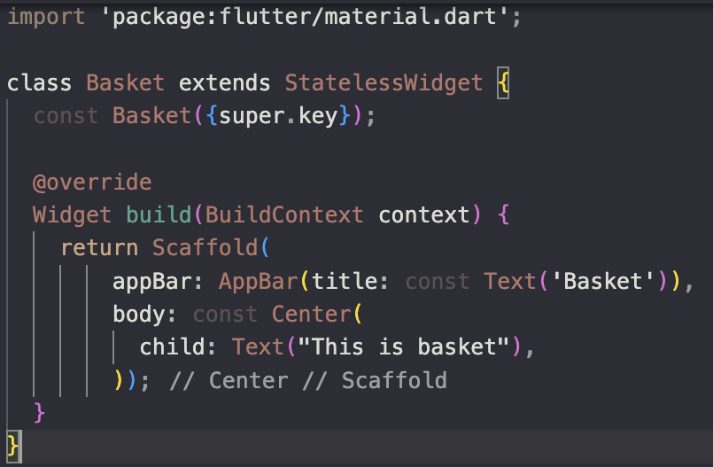
Preparation
Sometime the screen content can be different depend on parameter we send to it. For example, a DetailProduct screen will show different product data and product image while it gets different parameter value which usually the productid.
We will try to simulate this with Basket and ItemBasket screen.
Create a new screen, the Basket screen. This screen is opened via our existing basket menu in drawer. Nothing special here yet. You can do the similar steps when build About screen.
  Right click on lib > new file > “basket.dart”
  Basket screen use stateless widget

Slide 23
The ItemBasket screen
Create again new screen, the ItemBasket screen.
  Right click on lib > new file > “itembasket.dart”
This screen is opened from basket screen with different parameter. We prepare 2 parameter, id and count.
It can be done by providing these 2 variables and use it in the constructor.
import 'package:flutter/material.dart';
class ItemBasket extends StatelessWidget {
final int id;
final int count;
const ItemBasket(this.id, this.count, {super.key});
@override
Widget build(BuildContext context) {
return Scaffold(
appBar: AppBar(title: const Text('Item Basket')),
body: Center(child: Text("Item $id count= $count")),
);
}
}

Slide 24
Modify the Basket screen
Go back to basket.dart screen
Add following import import 'itembasket.dart';
modify the Center widget with a Column widget. Column is a multi-child layout widget while Center is a single-child layout widget.
Column is a widget that displays its children in a vertical array.
Center(
child: Column(children: [
const Text("This is Basket"),
ElevatedButton(
onPressed: () {
Navigator.push(context,
MaterialPageRoute(builder: (context) => const ItemBasket(1, 10)));
},
child: const Text("Item 1")),
ElevatedButton(
onPressed: () {
Navigator.push(context,
MaterialPageRoute(builder: (context) => const ItemBasket(2, 14)));
},
child: const Text("Item 2"))
]),
Open ItemBasket screen with additional parameter: id = 1, count =10
More about layout widget will be explained in next topic.

Slide 25
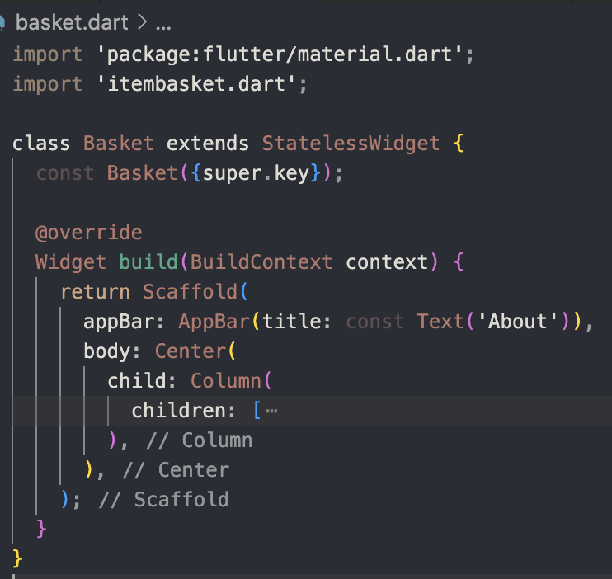
Modify the Basket screen
Do not add “const” in front of Center. Navigator.push(...) inside the onPressed of ElevatedButton is not const. it uses runtime values (context and ItemBasket()). Otherwise it will makes the compiler complain:
“Invalid constant value”.

Slide 26
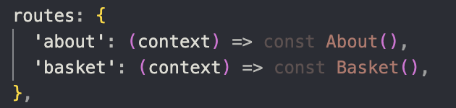
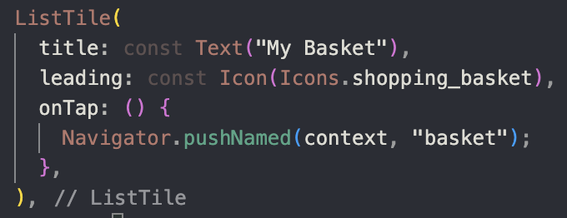
Make A Route to Basket Screen
Go back to main.dart
Add import: import 'basket.dart';
You can add routes to the basket dart either using MaterialPageRoute or Named Route. Following example using Named Route

Slide 27

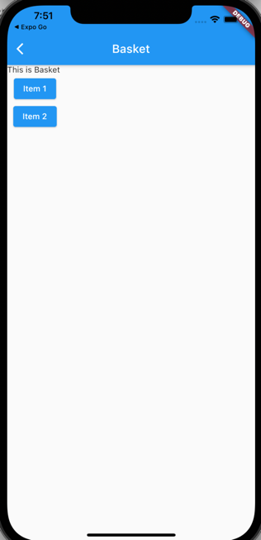
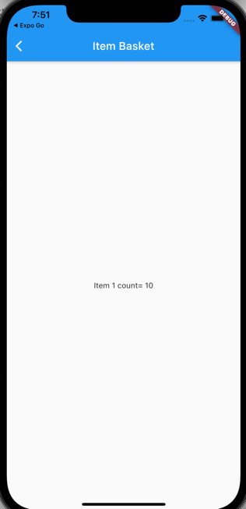
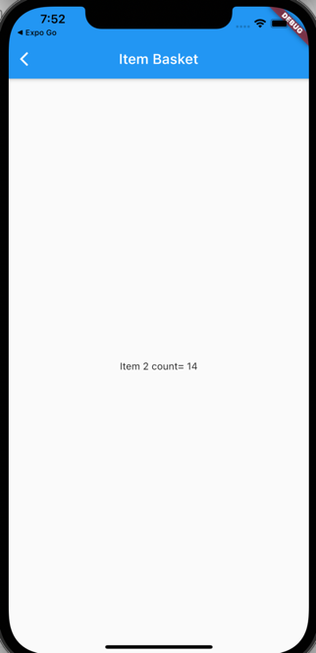
Result

Slide 28
CHANGE SCREEN IN TAB
05

Slide 29
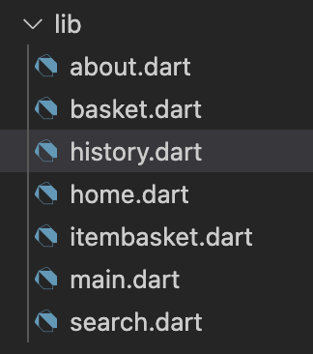
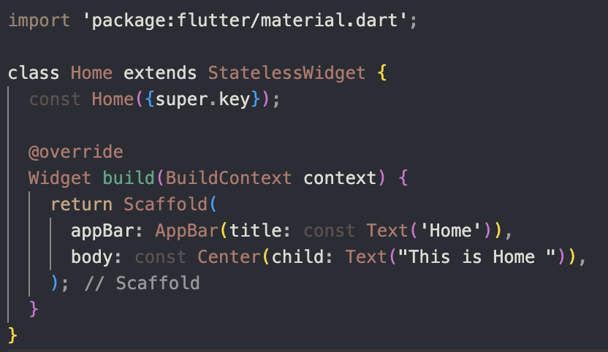
Preparation
In our existing app, we already have tab navigation. Now, we will make this tab navigation for changing screen. Not like the menu in the drawer, The tab navigation will not put the screen on the stack. It like changing the screen instead of stacking it.
The tab has 3 menus: Home, Search, and History. Create this 3 screen with a minimum feature like the about screen.

Slide 30
Modify main.dart
Add List of screen and variable that store current index. Dont forget to import the required screens
Add List of screen and currentIndex variable
class _MyHomePageState extends State<MyHomePage> {
int _counter = 0;
int _currentIndex = 0;
final List<Widget> _screens =
[Home(), Search(), History()];
Modify bottomnavigationbar
currentIndex: _currentIndex,
onTap: (int index) {
setState(() {
_currentIndex = index;
});
},
Modify scaffold body to use above list
body: _screens[_currentIndex],

Slide 31
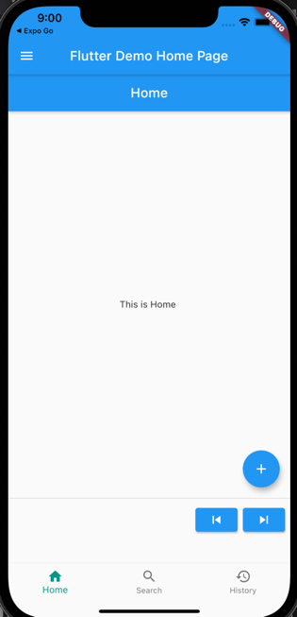
Result
The appbar is doubled !
There are 2 choices:
Remove appbar from main.dart scaffold.
  easy, but you will lost the hamburger icon
Remove appbar in each screen and modify the appbar title in main scaffold
  prepare list of string to store title
final List<String> _title = ['Home', 'Search', 'History'];
  modify the appbar title
  title: Text(_title[_currentIndex])

Slide 32
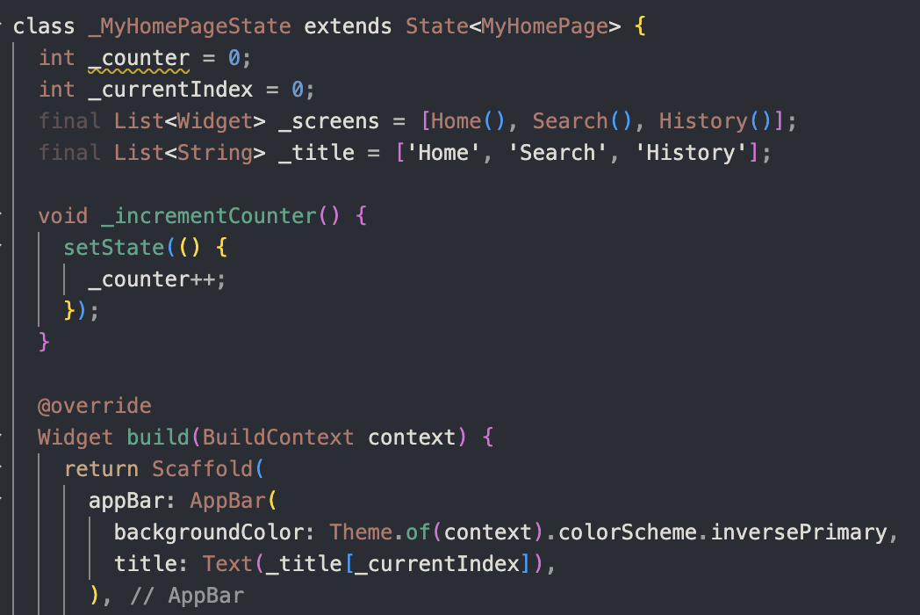
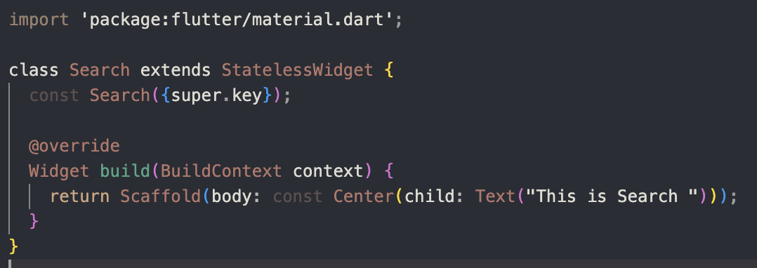
Result
Remove appBar (example in search.dart)

Slide 33
EXERCISE
06

Slide 34

Class Activity(30 Minutes)
If we can use Image.network(url) for showing image from internet, and from pravatar website we can pick the specific example image by using:
https://i.pravatar.cc/300?img=[imagenumber]
*imagenumber 1 to 70
Build StudentList and StudentDetail Screen.
Open StudentList from drawer menu.
In student list, put 3 buttons with caption Student #number.
Put different number you like from 1 to 70. If user click this button, open the StudentDetail screen which show the picture of the student (from pravatar website)
Upload Class Activity Result into ULS(lib folder only)

Slide 35
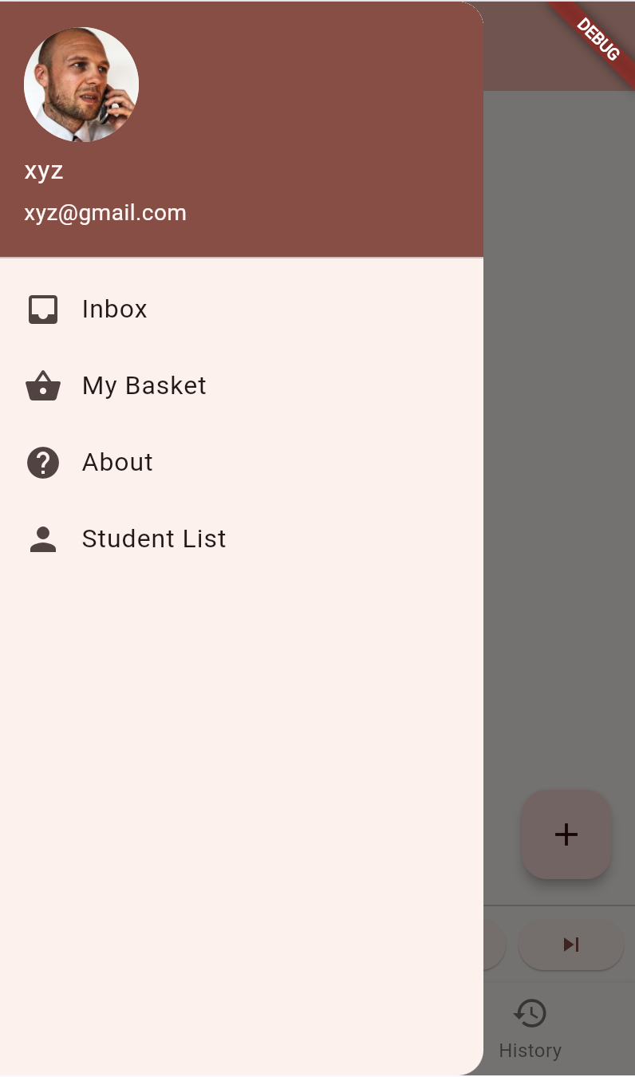
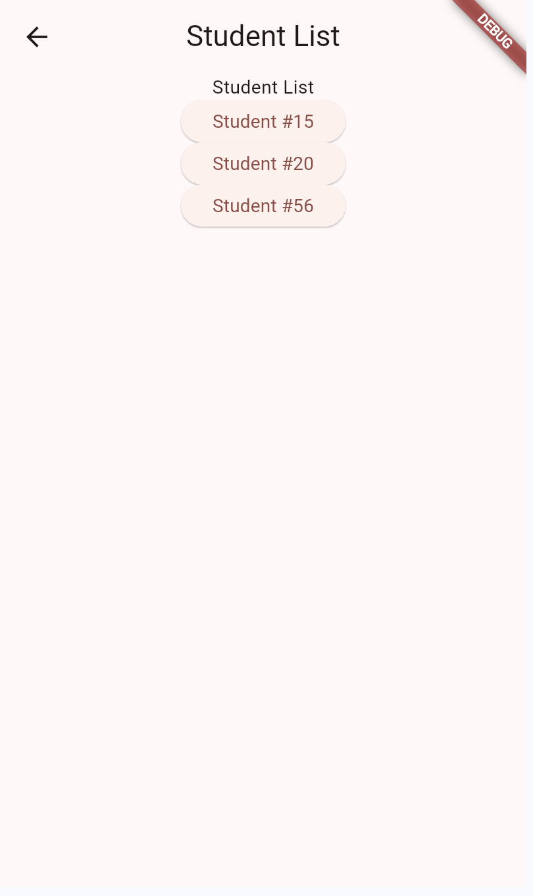
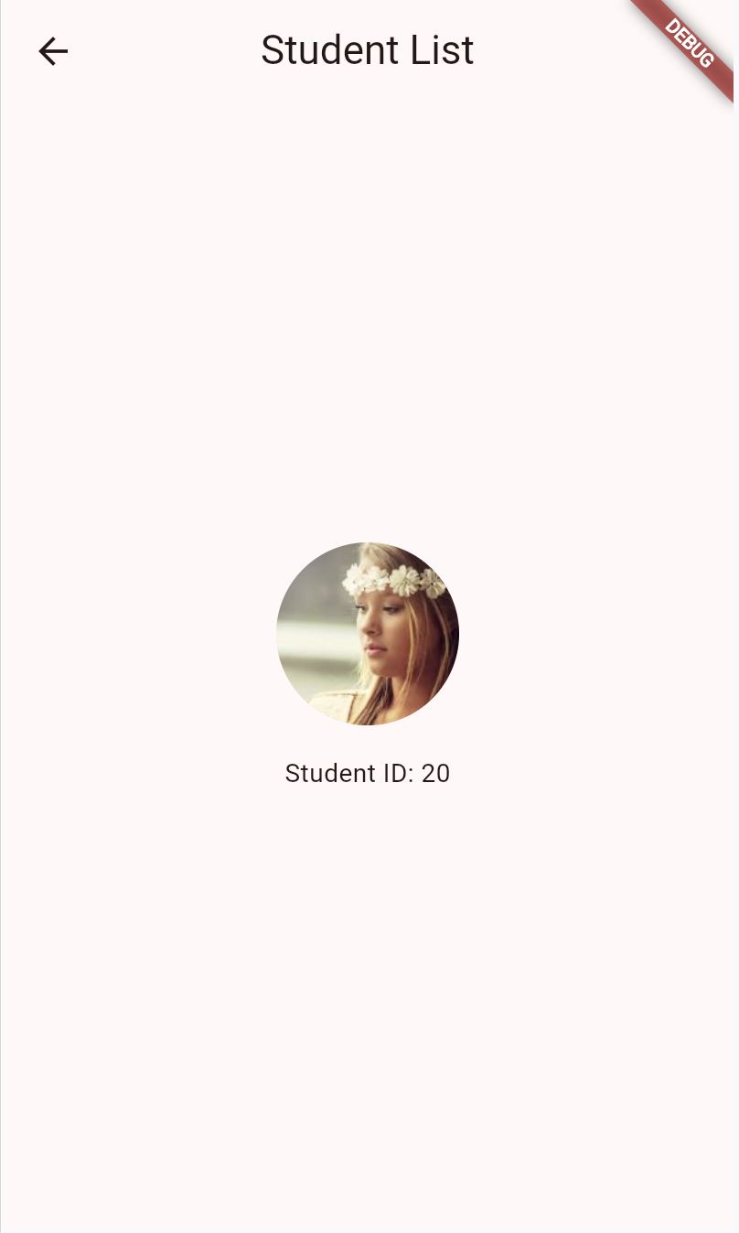
Exercise Result

Slide 36
Additional Sources
Learn different UI Widget:
https://docs.flutter.dev/ui/widgets/material (for Android)
https://docs.flutter.dev/ui/widgets/cupertino (for iOS)
To use Cupertino (iOS theme), import package:flutter/cupertino.dart

Slide 37



